Slide 1


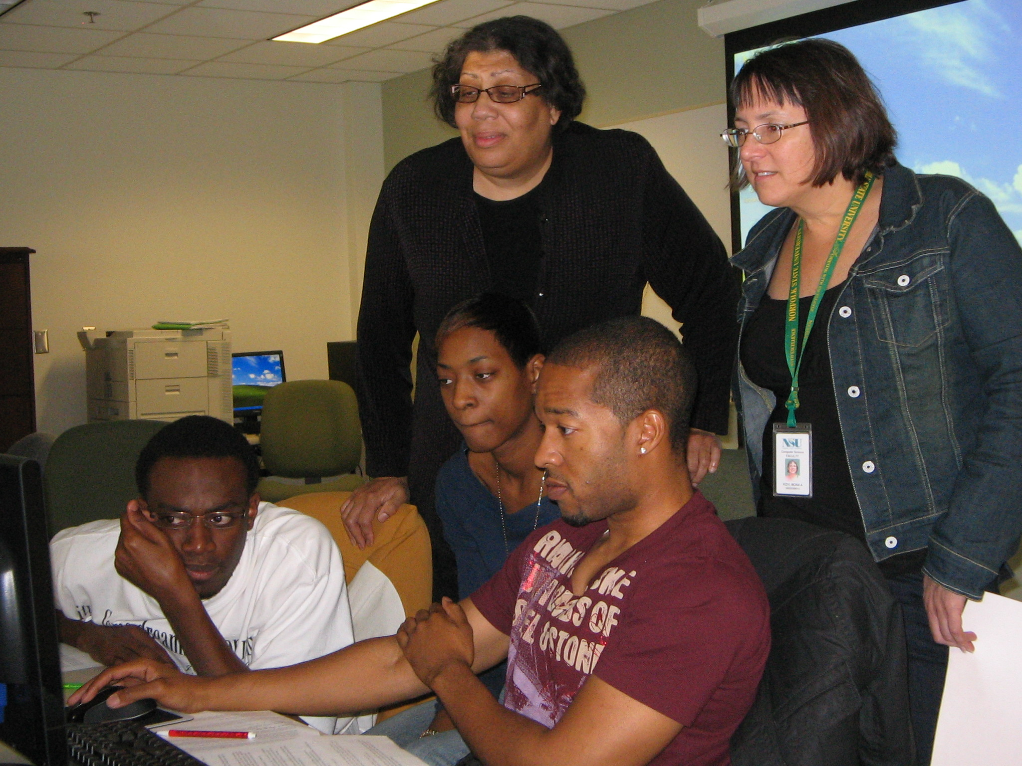

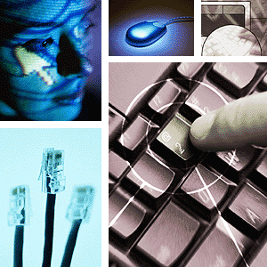
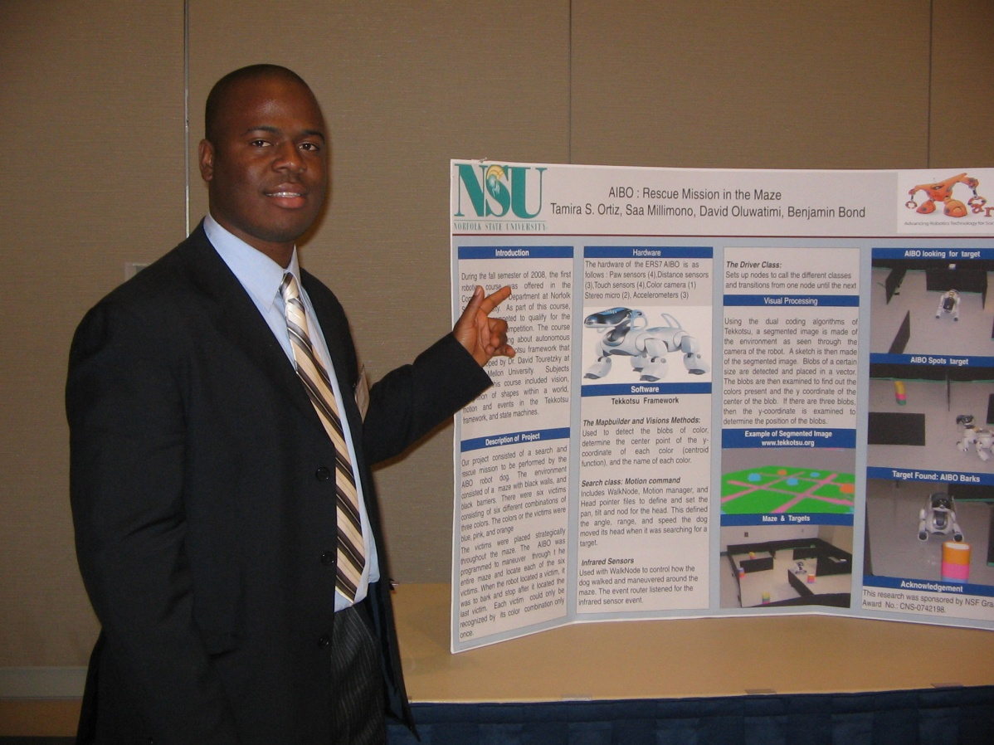


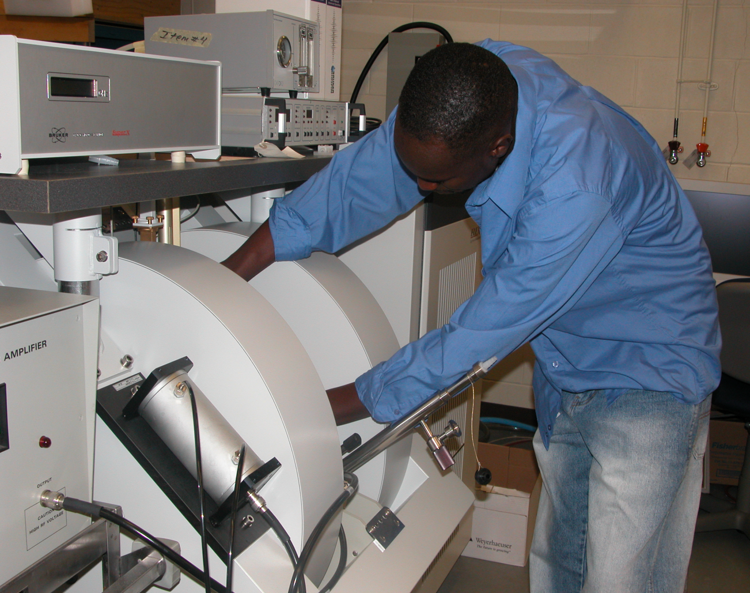

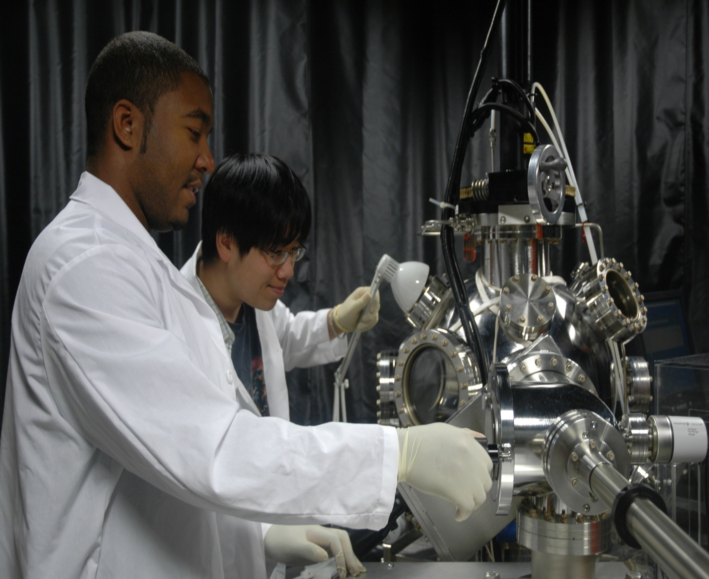
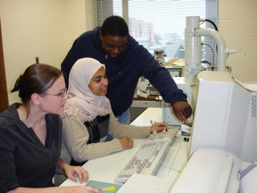
Research Centers & Laboratories
Computer Science
Institute for Information Assurance Research
Network Defense Lab (CISCO)
Robotics Lab
Center for Applied Sensors, Science, and Technology in
Wireless Security
NSA/ DHS Designated Center of Academic Excellence in
Information Assurance
Materials Science & Engineering
Creative Gaming and Simulation Lab
Center for Materials Research (CMR)
NMR and ESR Labs
Laser Spectroscopy lab
Crystal Growth Lab
Class 100/1000 Clean Room
Polymer Synthesis and
Thin Film Lab
Characterization
SciViz Computational Center
Developed the worlds smallest laser, the "spaser", with collaborators from Cornell University and Purdue University

Slide 2

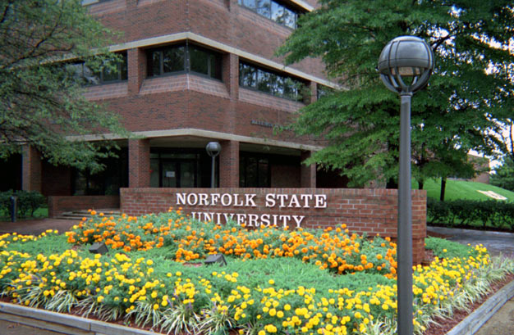

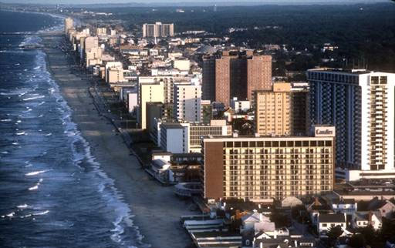




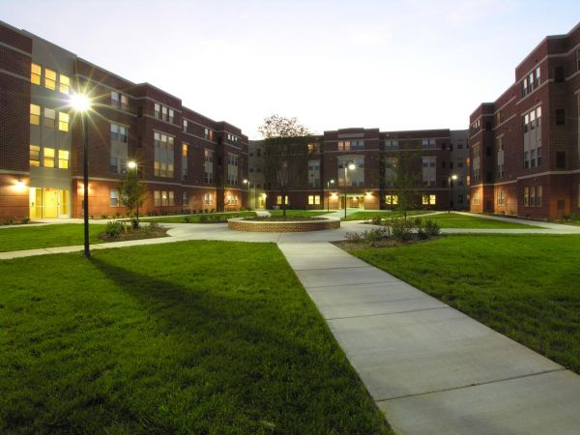



WHY NSU

